Slide 1
Mobile Computing
By Madiha Hameed

Slide 2
Table of Contents
Introduction
Purpose
Application

Slide 3
Introduction
What is Mobile
History
What is Mobile Application Development
What is Android

Slide 4
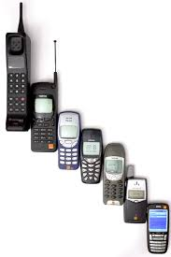
What is Mobile
A mobile phone, cell phone or hand phone, sometimes shortened to simply mobile, cell or just phone, is a portable telephone that can make and receive calls over a radio frequency link while the user is moving within a telephone service area.

Slide 5
History
1983
The world’s first cell phone was launched in 1983. It was the Motorola DynaTAC 800x. It was priced at around $4,000 and lasted for 30 minutes of talk time before dying. It was also about the size of a foot long sub from Subway.
1908
one man claimed to have invented a wireless telephone. That man was considered so crazy for his time that he was accused of fraud. The charges were later dropped
1924
in 1924, wireless phones were tested on trains running between Berlin and Hamburg.

Slide 6
1946
June 17, Bell Labs had begun to offer mobile telephone services on vehicles in St. Louis, Missouri. A few weeks later, AT&T matched Bell Labs, offering something called Mobile Telephone Service, which was a wide range of mostly incompatible mobile telephone services that offered limited coverage areas and a small number of available channels.
Between 1957 and 1961
Soviet inventor Leonid Kupriyanovich developed a number of mobile phones that looked surprisingly similar to modern mobile devices. One of Leonid’s phones weighed just 70 grams and could easily fit into the palm of your hand.
1G was first deployed in Tokyo in 1979
2G 2001
2007, there were 295 million 3G users around the world.
4G 2005

Slide 7
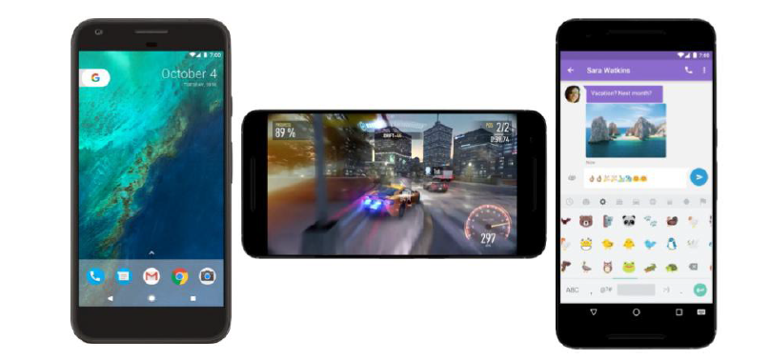
What is Mobile Application Development
Is a process of develop application for mobiles ,tablets, personal assistance , or enterprise digital assistance.

Slide 8
Clint Side --→ XML
Server Side ------→ JAVA
Connector -------→ OOP
OOP have four pillar
Inheritance
Copy of one class function to all other classes
Polymorphism
Use one thing in different way may it will be dynamic or static
Encapsulation
Hiding data may it public ,private, specifier, interprotected
Abstraction
One class function used in different classes

Slide 9
What is Android
Android is an open source operating system
A programming platform developed by Google for smartphones and other mobile devices(such as tablets).
It can run on many different devices from many different manufacturers.
Android includes a software development kit for writing original code and assembling software modules to create apps for Android users.
It also provides a marketplace to distribute apps.
Android represents an ecosystem for mobile apps.

Slide 10
Why Android Development?
Reason of Development is to provide ease of working to
Services Provider
Ecommerce business
Gamers
Travelers ….et….
Developers choose to develop for Android in order to reach the majority of mobile device users.

Slide 11
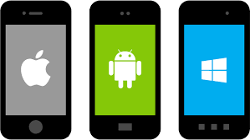
Types of Mobile Application
Native
Java, C#, Switch ,objective C
Cross
HTML, CSS

Slide 12
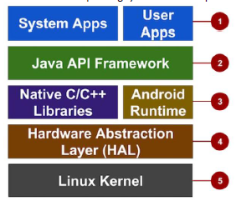
ANDROID DEVELOPMENT ARCHITECTURE
Android provides a rich development architecture. You don’t need to know much about the components of this architecture, but it is useful to know what is available in the system for your app to use. The following diagram shows the major components of the Android stack the operating system and development architecture.

Slide 13
Android Architecture
Apps: Your apps live at this level, along with core system apps for email, SMS messaging, calendars, Internet browsing, or contacts.
Java API Framework: All features of Android are available to developers through application programming interfaces (APIs) written in the Java language. You don't need to know the details of all of the APIs to learn how to develop Android apps, but you can learn more about the following APIs, which are useful for creating apps:
View System used to build an app's UI, including lists, buttons, and menus.
Resource Manager used to access to non-code resources such as localized strings, graphics, and layout files.
Notification Manager used to display custom alerts in the status bar.
Activity Manager that manages the lifecycle of apps.
Content Providers that enable apps to access data from other apps.
All framework APIs that Android system apps use.

Slide 14
Libraries and Android Runtime: Each app runs in its own process and with its own instance of the Android Runtime, which enables multiple virtual machines on low-memory devices. Android also includes a set of core runtime libraries that provide most of the functionality of the Java programming language, including some Java 8 language features that the Java API framework uses. Many core Android system components and services are built from native code that require native libraries written in C and C++. These native libraries are available to apps through the Java API framework.
Hardware Abstraction Layer (HAL): This layer provides standard interfaces that expose device hardware capabilities to the higher-level Java API framework. The HAL consists of multiple library modules, each of which implements an interface for a specific type of hardware component, such as the camera or Bluetooth module.
Linux Kernel: The foundation of the Android platform is the Linux kernel. The above layers rely on the Linux kernel for underlying functionalities such as threading and low-level memory management. Using a Linux kernel enables Android to take advantage of key security features and allows device manufacturers to develop hardware drivers for a well-known kernel.

Slide 15
Review of lecture
What
Why
How

Slide 16

Questions

